Slide 1
Minufiya University
Faculty of Electronic Engineering
Dep. of Electronic and Communication Eng.
4’th Year
Information Theory and Coding
Lecture on:
Performance Analysis of Turbo Code
Prof. Atef Abou-El-Azm
Eng. Waleed Saad

Slide 2
Outlines
Frame Size
Encoder Memory Size
Encoder Output Puncturing
Number of decoder iterations
Noise level
Performance analysis of Turbo Code
Limitations of Turbo code in wireless communications
Rayleigh fading
Unreliable channel
Changing environment
Tight timing
Small frame size
Limited bandwidth
Proposal on wireless communications
Proposal on multi-media applications

Slide 3
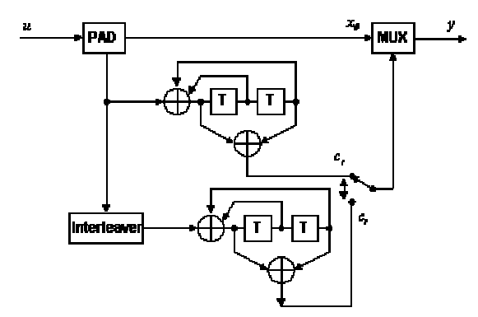
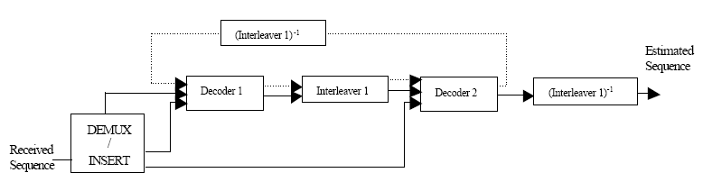
Performance analysis of Turbo Code
Frame size
The larger the frame size, the bits can be interleaved with larger distance. Thus the correlation between adjacent bits will become smaller. This will give better performance on Turbo Code in terms of accuracy.
The size of trellis formed is linearly proportional to the frame size. The complexity of the decoding algorithm is independent of the frame size.
Thus, increasing the frame size will
make the whole decoding process longer, thus increasing the latency.
10111001

Slide 4

Performance analysis of Turbo Code
Encoder memory size
The memory size of an encoder is the number of bit/state can be stored in the encoder. In our example the encoder has a memory size of 2.
For larger memory size, Turbo Code has better performance as the coding algorithm becomes more sophisticated.
The number of state n is exponentially
proportional to the memory size m.( )
Thus, the decoding time increases dramatically with the memory size. The latency will increase exponentially too.

Slide 5
Performance analysis of Turbo Code
Encoder Output Puncturing
If output puncturing is implemented, the code rate will be restricted to 1/2. This is useful in circumstances which the bandwidth limitation is so great that additional redundancy of code to achieve a code rate of less than 1/2 is undesirable.
However, as output is punctured, some information is loss. That means the performance of Turbo Code will decrease in general. Bit error rate (BER) will increase.

Slide 6
Performance analysis of Turbo Code
Number of decoder iterations
Firstly, the decoder gets the systematic output and also the first encoder output, while the second decoder gets the information of the systematic output and also the second encoder output.
The first decoder does not have the information of the second encoder output in the first iterations.
The performance of the Turbo Code increases as the number of iterations increases. However, the time used will also increases linearly as the number of iterations. This increases in decoding time per bits will lead to increase in latency.

Slide 7
Performance analysis of Turbo Code
Noise level
The most direct factor to affect the performance of Turbo Code is noise level.
Noise level can be represented by signal energy per bit to noise power spectral density (Eb/No).
The larger the Eb/No, the smaller the noise level. With more favorable environment, the BER of the Turbo Code will decrease, and vice versa.
TX
RX

Slide 8
Outlines
Frame Size
Encoder Memory Size
Encoder Output Puncturing
Number of decoder iterations
Noise level
Performance analysis of Turbo Code
Limitations of Turbo code in wireless communications
Rayleigh fading
Unreliable channel
Changing environment
Tight timing
Small frame size
Limited bandwidth
Proposal on wireless communications
Proposal on multi-media applications

Slide 9
Limitations of Turbo code in wireless communications
Rayleigh fading
Power
path-1
noise
path-2
path-3
multi-path propagation
path-2
Path Delay
path-1
BER
path-3
Mobile Station (MS)
Base Station (BS)
AWGN channel
No. of iterations

Slide 10
Limitations of Turbo code in wireless communications
Unreliable channel
Power
path-1
path-2
path-3
multi-path propagation
path-2
Path Delay
path-1
path-3
Mobile Station (MS)
Base Station (BS)
Fading effect due to multipath time delay and frequency selective fading has make the wireless communication channel suffer much higher noise level than the wired one which affect the BER.

Slide 11
Limitations of Turbo code in wireless communications
Changing environment
Power
path-1
path-2
path-3
multi-path propagation
path-2
Path Delay
path-1
path-3
Mobile Station (MS)
Base Station (BS)
Besides the high noise level, its level is changing. This is due to the movement of the mobile users. This makes the communication more unpredictable which makes the code design more difficult.

Slide 12


Limitations of Turbo code in wireless communications
Tight timing
Voice information must arrive in time. Late coming voice will generate inconvenience to listeners.
So, turbo code with a large no. of iterations is impossible for real time communications.

Slide 13



Limitations of Turbo code in wireless communications
Small frame size
100110000111110 10101
The channel is unreliable →
large frame size means higher error, frame lost, can’t be recover ...
Real time nature →
the system can’t wait for decoder latency.

Slide 14

Limitations of Turbo code in wireless communications
Limited bandwidth
Wireless channel spectrum is shared among the public. Each are given a limited BW.
So, turbo code should be with a little redundancy.

Slide 15
Outlines
Frame Size
Encoder Memory Size
Encoder Output Puncturing
Number of decoder iterations
Noise level
Performance analysis of Turbo Code
Limitations of Turbo code in wireless communications
Rayleigh fading
Unreliable channel
Changing environment
Tight timing
Small frame size
Limited bandwidth
Proposal on wireless communications
Proposal on multi-media applications

Slide 16
Proposal on wireless communications
No output puncturing
Dynamic decoding scheme
Multiple channel transmission
Make use of existing wireless protocols
Additional interleaving
No-puncture
BER is better
BW increases
Latency increases
Decoding with knowledge of channel characteristics

Slide 17
Proposal on wireless communications
No output puncturing
Dynamic decoding scheme
Multiple channel transmission
Make use of existing wireless protocols
Additional interleaving
With dynamic decoding
Stop decoding once the frame is error free.
Most of frames can be recovered with iterations↓
More errors → more iterations
Decoding with knowledge of channel characteristics

Slide 18
Proposal on wireless communications
No output puncturing
xo
Turbo
Enc.
c1
MUX
De-MUX
Turbo
Dec.
channel
Dynamic decoding scheme
c2
Multiple channel transmission
Turbo
Enc.
channel
Turbo
Dec.
channel
Make use of existing wireless protocols
channel
Additional interleaving
If one channel becomes noisy, the whole transmission suffers.
To avoid fading channels, spread the contents over multiple channels.
TDM can be used for each channel to increase capacity over the same BW.
Decoding with knowledge of channel characteristics

Slide 19
Proposal on wireless communications
GSM
No output puncturing
→ Digitizing → convolution coding → interleaving
→Burst formatting → Ciphering → Modulation →
Dynamic decoding scheme
Multiple channel transmission
Digitizing → Turbo coding
→Burst formatting → Ciphering → Modulation →
Make use of existing wireless protocols
Additional interleaving
Replacing the convolution coding with turbo coding → interleaving in GSM can be by-passed or used for better performance.
Decoding with knowledge of channel characteristics

Slide 20
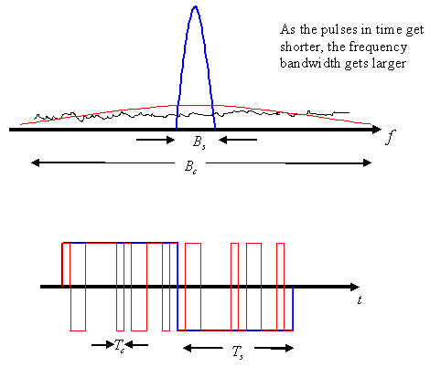
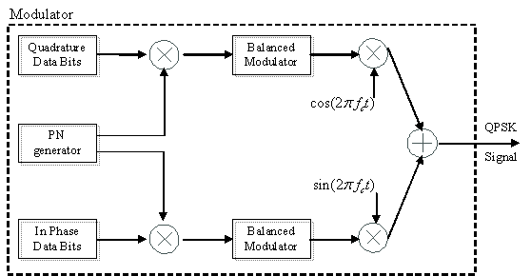
Proposal on wireless communications
CDMA
No output puncturing
Dynamic decoding scheme
Multiple channel transmission
Make use of existing wireless protocols
Additional interleaving
The narrow band signal is multiplied by a very large BW signal called the spreading signal which is pseudo noise (PN) code.
Decoding with knowledge of channel characteristics

Slide 21
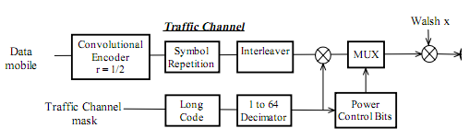
Proposal on wireless communications
CDMA
No output puncturing
Dynamic decoding scheme
Pilot, sync, traffic, paging
Multiple channel transmission
traffic, access
Make use of existing wireless protocols
Additional interleaving
The forward channel (from base station to mobile)
→ The convolution code r=1/2 → turbo code pun.
The reverse channel (from mobile to base station)
The convolution code r=1/3 → turbo no-pun.
Decoding with knowledge of channel characteristics

Slide 22
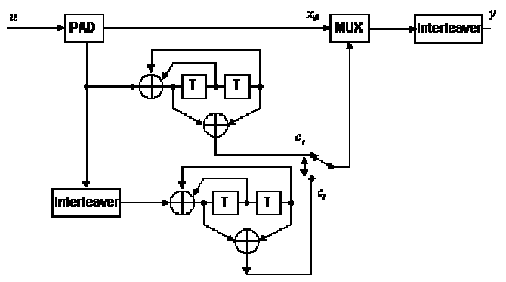
Proposal on wireless communications
No output puncturing
Dynamic decoding scheme
Multiple channel transmission
Make use of existing wireless protocols
Additional interleaving
Adding extra interleaver after MUX → correlation between adjacent transmitted bits ↓ → BER ↓
Decoding with knowledge of channel characteristics

Slide 23
Proposal on wireless communications
No output puncturing
Dynamic decoding scheme
Turbo
Enc.
channel
Turbo
Dec.
channel
Multiple channel transmission
channel
Make use of existing wireless protocols
Additional interleaving
Knowledge of channel fading factor can do better encoding and improve the accuracy.
1- channel char. → BER for each ch. → noise level
2- multichannel tx. → correlation, deterioration ↓
3- weighted turbo decoding
Decoding with knowledge of channel characteristics

Slide 24
Outlines
Frame Size
Encoder Memory Size
Encoder Output Puncturing
Number of decoder iterations
Noise level
Performance analysis of Turbo Code
Limitations of Turbo code in wireless communications
Rayleigh fading
Unreliable channel
Changing environment
Tight timing
Small frame size
Limited bandwidth
Proposal on wireless communications
Proposal on multi-media applications

Slide 25
Proposal on multi-media applications
Self prepare

